Slide 1

Large-scale Commercial
Heat Pump Water Heaters

Slide 2
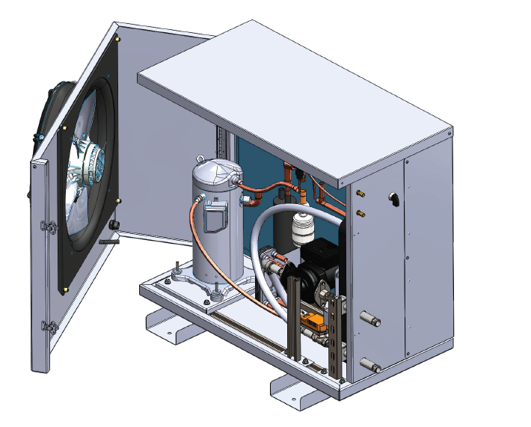
Unit Design
  Electrically-driven
  Uses refrigeration cycle
  Air or water source
  Direct heating of potable water

Slide 3
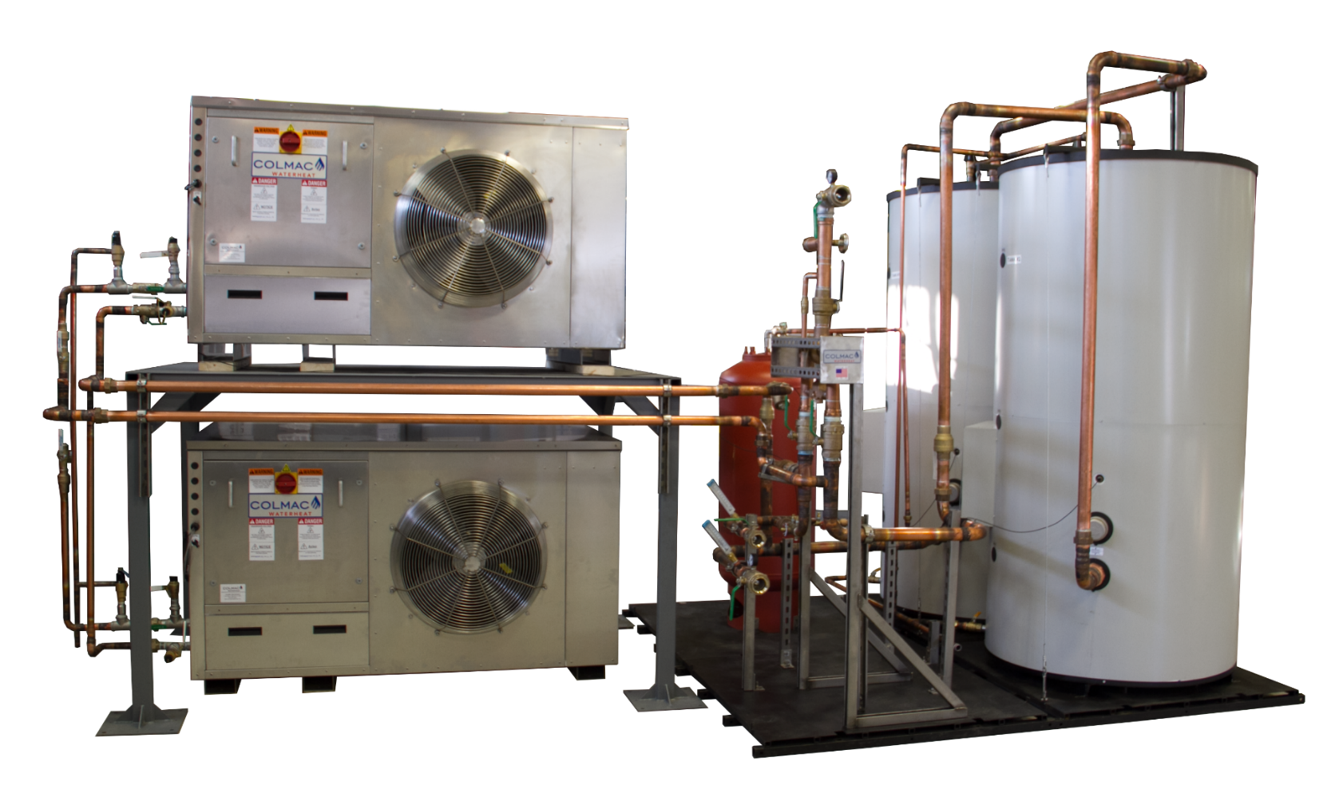
System Design
  Pair with storage tanks
  Store at 140ºF-160ºF and mix down

Slide 4
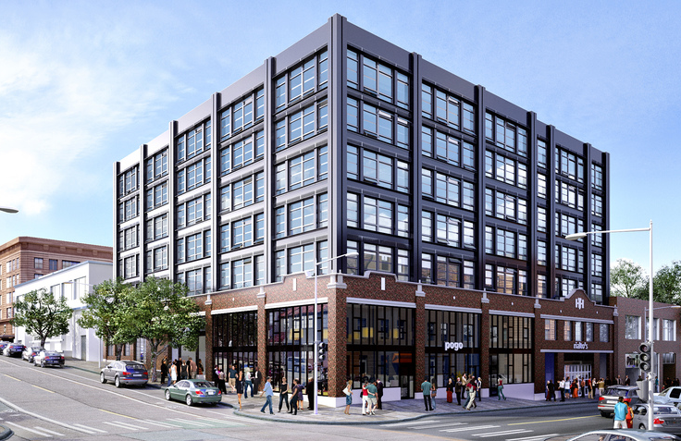
Large-scale Applications
  Multifamily
  Hotels
  Dormitories
  Barracks
  Schools
  Net Zero
  Passive House
  LEED

Slide 5

Benefits of HPWHs
  Electrification
  High Efficiency [COPs of 1.5 - 6]
  Free cooling or heat recovery
  Load shifting, night operation
  No exhaust piping or waste streams
  Low Maintenance

Slide 6
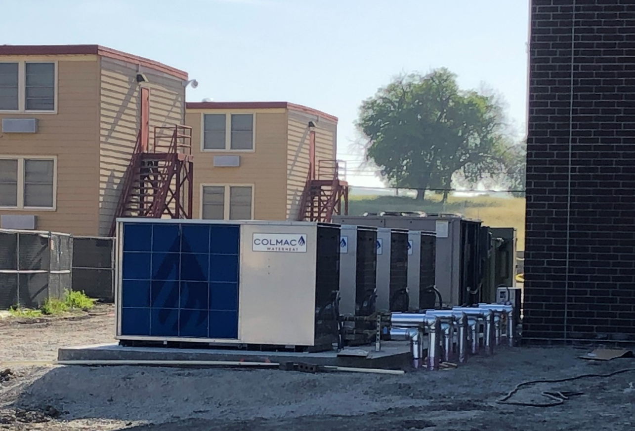
Sizing New HPWH Systems
  Longer runtimes, lower GPH recovery
  Pair with storage for peak load
  Select units for lowest design temperature
  Stage off units during warmer months

Slide 7
Required Design Information
  Source type
  Min and max source design temperatures
  Water temperatures (Supply, stored, mixed)
  Building/usage type(s)
  Total daily usage and peak hour usage (or building details)
  Building loop losses (btuh)

Slide 8
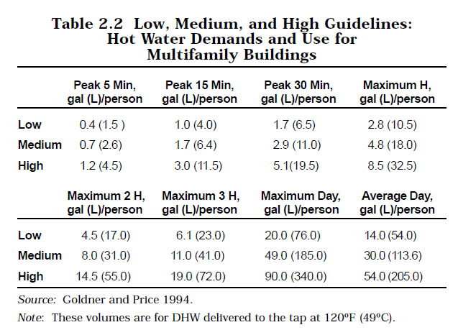
Total Daily Usage Sizing
  Estimate Occupancy
  ASPE/ASHRAE Daily Usage Per Person
  HPWH Required Recovery = Daily Usage / Desired Run Hours
Notes:
Combine heat pumps with storage to reduce equipment size
Daily recovery rather than hourly
Heat pumps cover total daily usage, tanks provide for peak loads

Slide 9
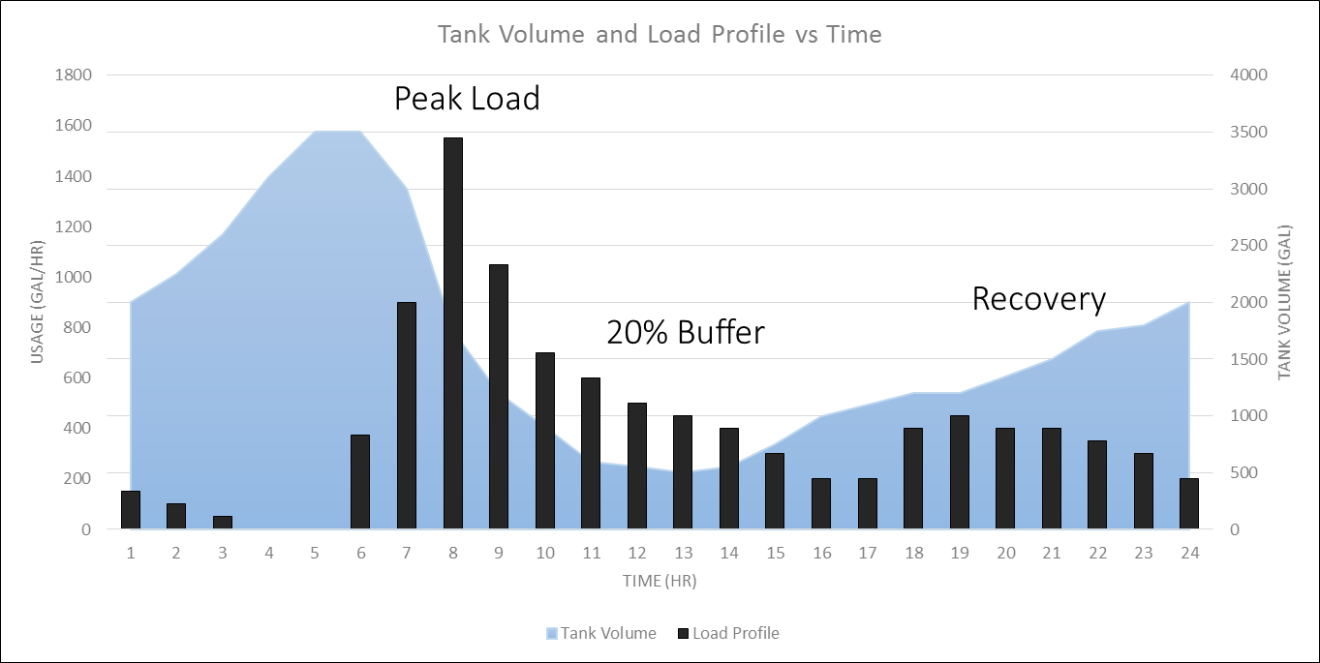
Daily Usage Profiles
  Hourly Load Profile or Peak 4 hr usage to size storage
  Size loop heater unit and recirc. tank to match recirc. losses
Notes:
Combine heat pumps with storage to reduce equipment size
Daily recovery rather than hourly
Heat pumps cover total daily usage, tanks provide for peak loads

Slide 10

Single vs Multi Pass Heating
E-TCV
Internal
Pump
Notes:
E-TCV valve is what we do differently
Meters domestic water flow, 100 degree lifts, constant output temperature
Circulator pump to tanks and back

Slide 11
Multi-pass Operation
  Higher flow, low lift
  Constant flow rate
  Varying output temperature
  Recirc. loop heating and retrofits
TMV
50 -140°F
T+10°F
HPWH
T
Cold Supply

Slide 12
Single pass Operation
  Lower flow, high lift
  Constant output temperature
  Varying flowrate
  Minimum lift required
  Size pipes for max flow rate
140°F
TMV
140°F
140°F
HPWH
50-120°F
Cold Supply

Slide 13
Stratified storage, Series tanks
TO
MIXING
VALVE
140°F
140°F
140°F
HPWH
COLD
SUPPLY

Slide 14
HPWH System Piping
To Mixing
Valve
HPWH
STORAGE
TANK
HPWH
STORAGE
TANK
LEAD
HPWH
EXP
COLD
SUPPLY

Slide 15
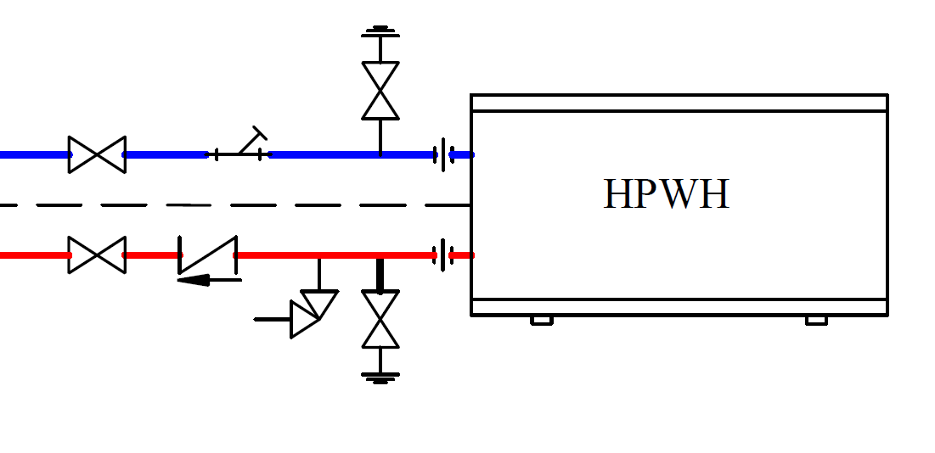
Recommended unit fittings

Slide 16
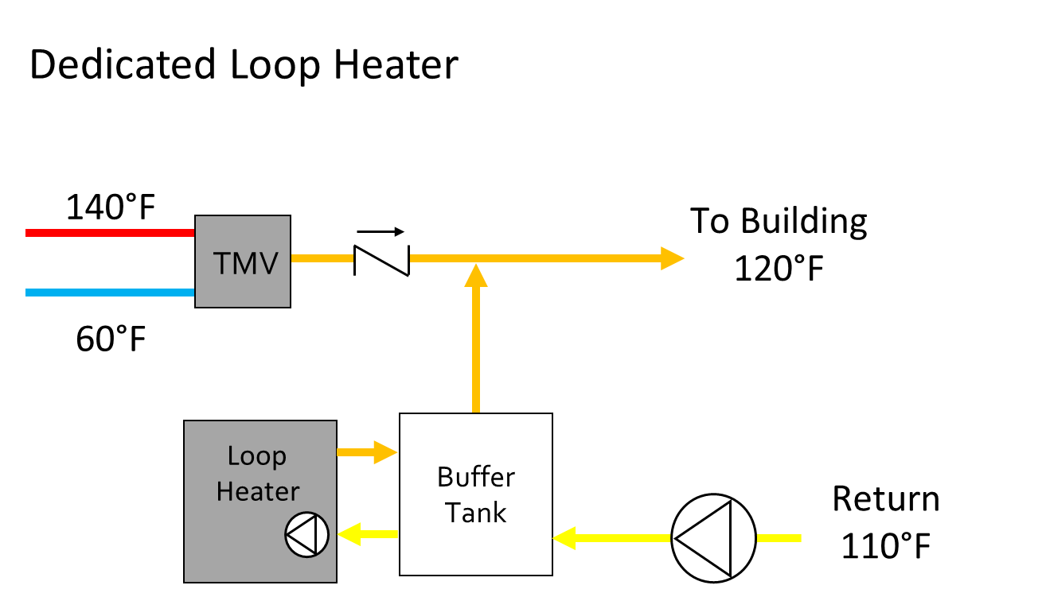
Recirc. Return Options

Slide 17
Recirc. Return Options
Return To Tanks
140°F
To Building
120°F
TMV
Aquastat
Return Water
110°F
< 120°F
Cold
<20%

Slide 18
HPWH System Piping
140-170°F
120-170°F
HPWH
MIXING
VALVE
STORAGE
TANK
HPWH
STORAGE
TANK
RECIRC
TANK
LEAD
HPWH
HPWH
EXP
HWR
110°F
COLD
SUPPLY

Slide 19
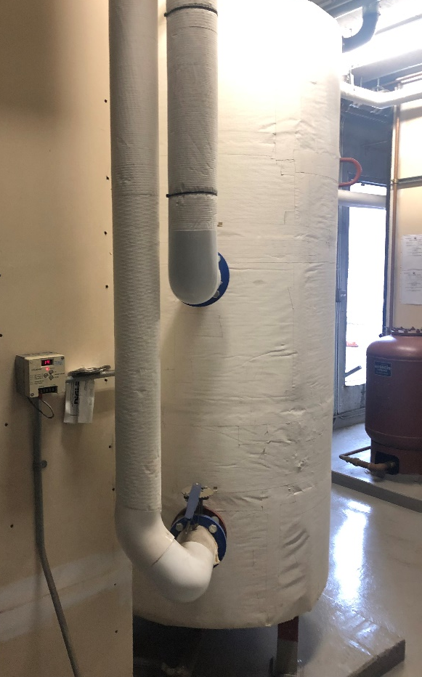
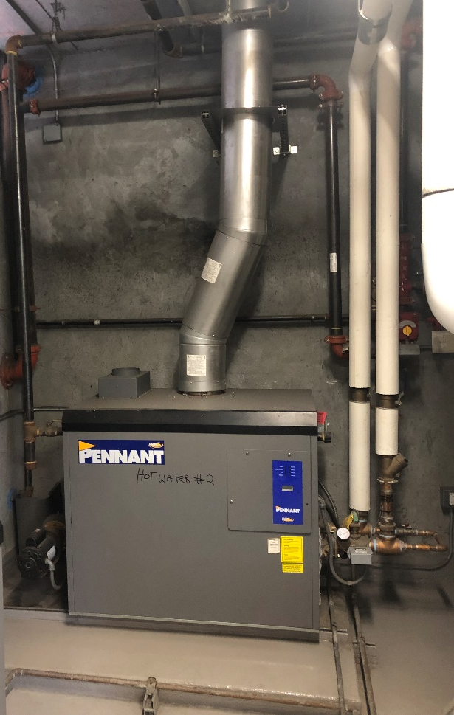
Retrofit Considerations
  Meter usage and losses
  Leave old equipment?
  Electrical service limitations
  Single or multi-pass

Slide 20
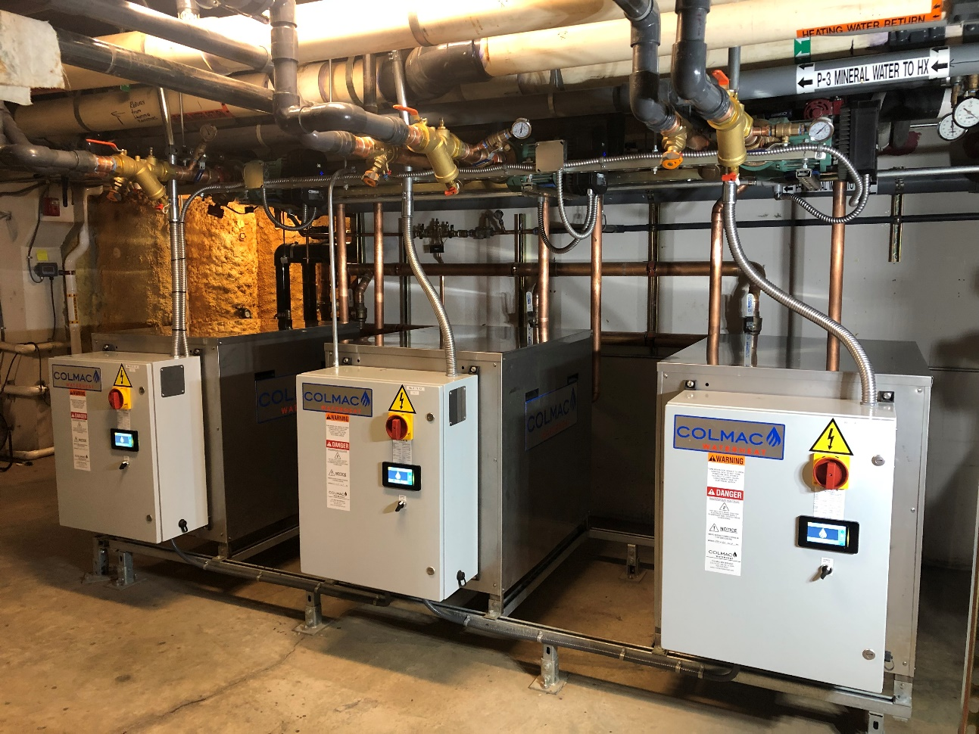
New Cx Series
Common control program across all models
PLC, touchscreen, EEVs standard
304L stainless cabinets standard
Interconnecting controls, 8 units staging and runtime balancing
Up to 30 hp compressors

Slide 21
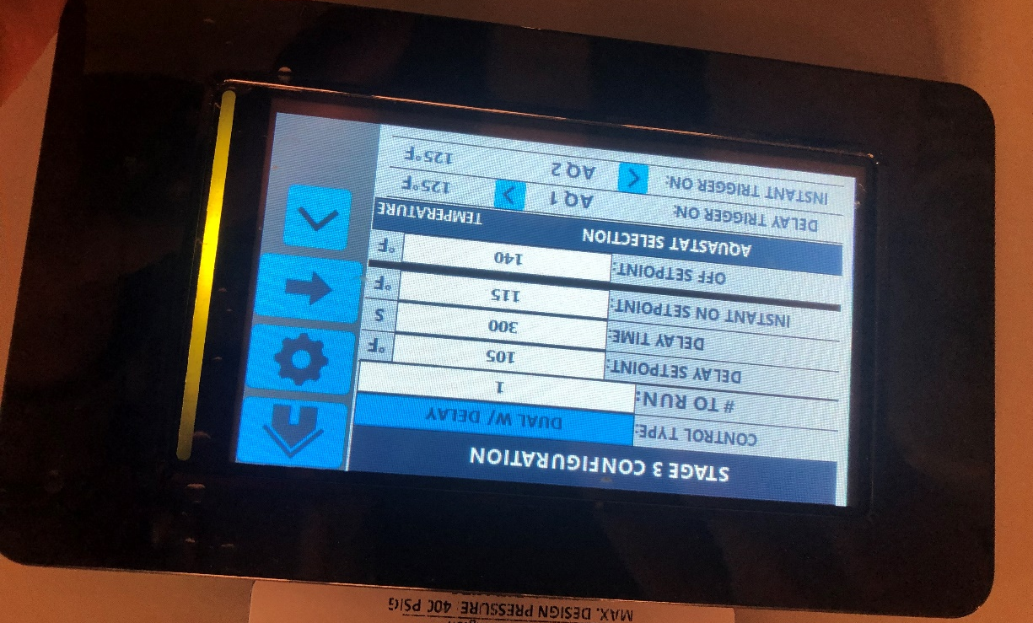
New Cx Series
Trends temperature history for 10 days
Download run data to USB
Upload new code updates from USB

Slide 22
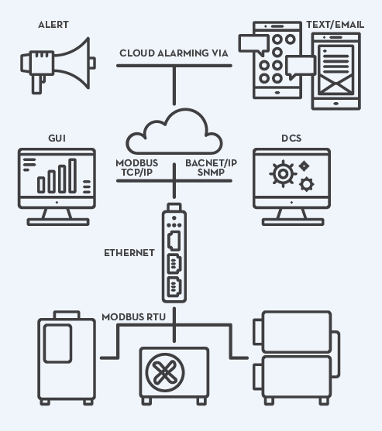
Cloud-Based Monitoring
  Free cloud data logging (1 year rolling)
  Email and text alerts
  Remote monitoring and troubleshooting
  One module required per array

Slide 23
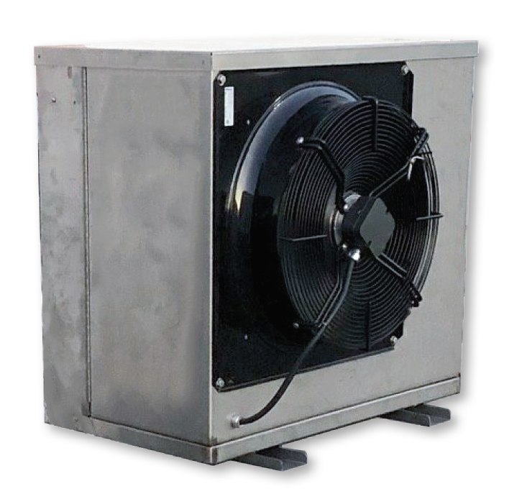
CxV-5: Air Source
4 Nominal Tons (48 MBH)
Prop fan only (not ECM)
Swing-open front panel for servicing
120°F Output
140°F Output
-4°F (-15C)
10°F (-10C)
100°F (38C)
50°F (13C)
Defrosts Required

Slide 24
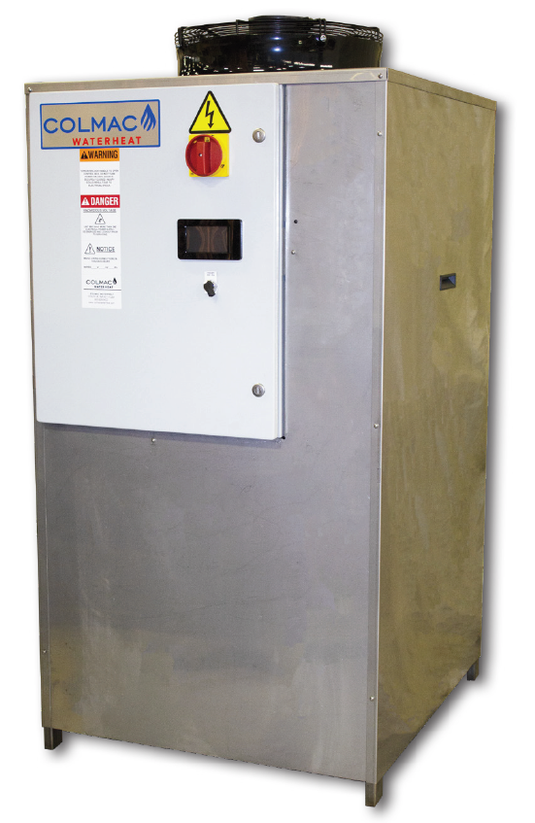
CxA-10 to -30: Air Source
10 – 25 Nominal Tons (120 – 300 MBH)
ECM fans, axial or plenum
2-3 in static with plenum fan
Electrocoated evaporators
Reduced footprint

Slide 25
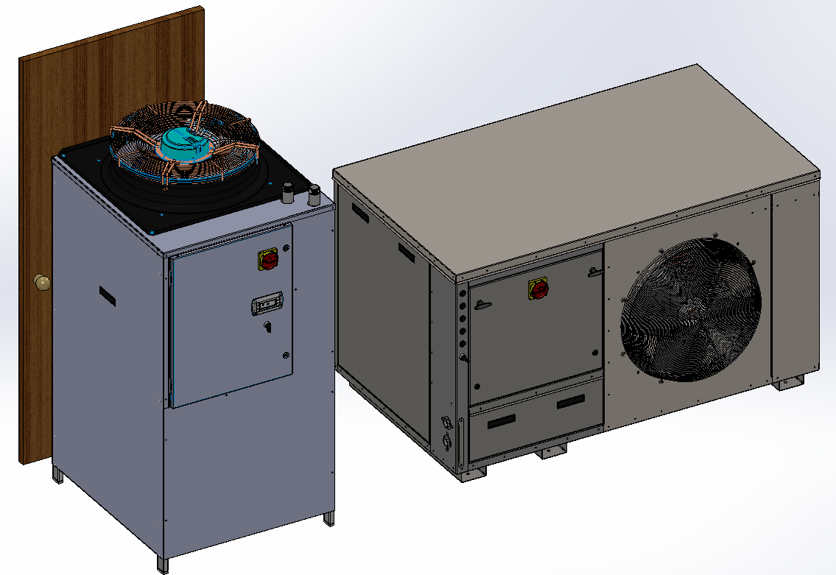
CxA: reduced footprint

Slide 26
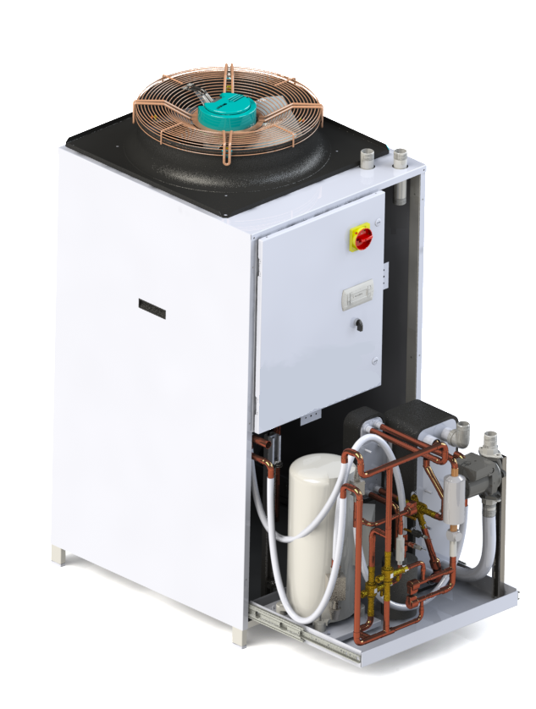
CxA: Air Source
Zero side clearance required
Slide-out tray for refrigeration component access

Slide 27
CxA Operating Range
120°F
Output
140°F
Output
28°F (-4C)
35°F (2C)
95°F (35C)
120°F (49C)
50°F (13C)
Defrosts Required
High Temp Compressor

Slide 28
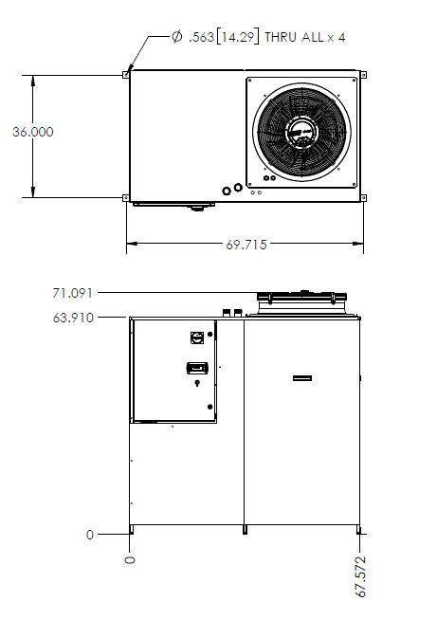
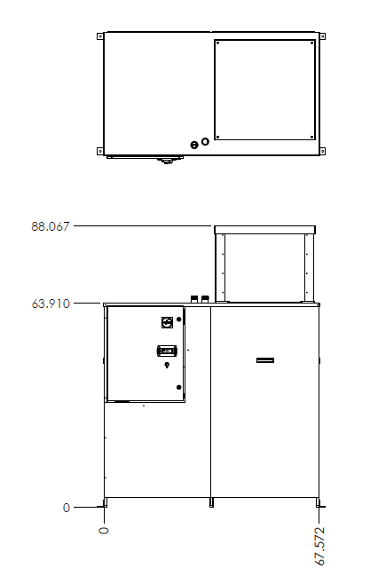
CxA: Air Source

Slide 29
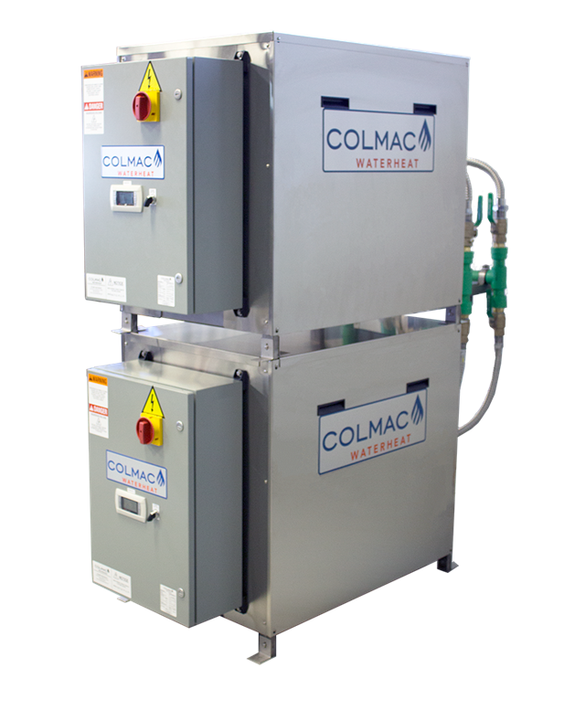
CxW: Water Source
9 – 25 Nominal Tons (108 – 300 MBH)
Single compressor / circuit
Stackable
Optional single point electrical and interconnecting headers

Slide 30
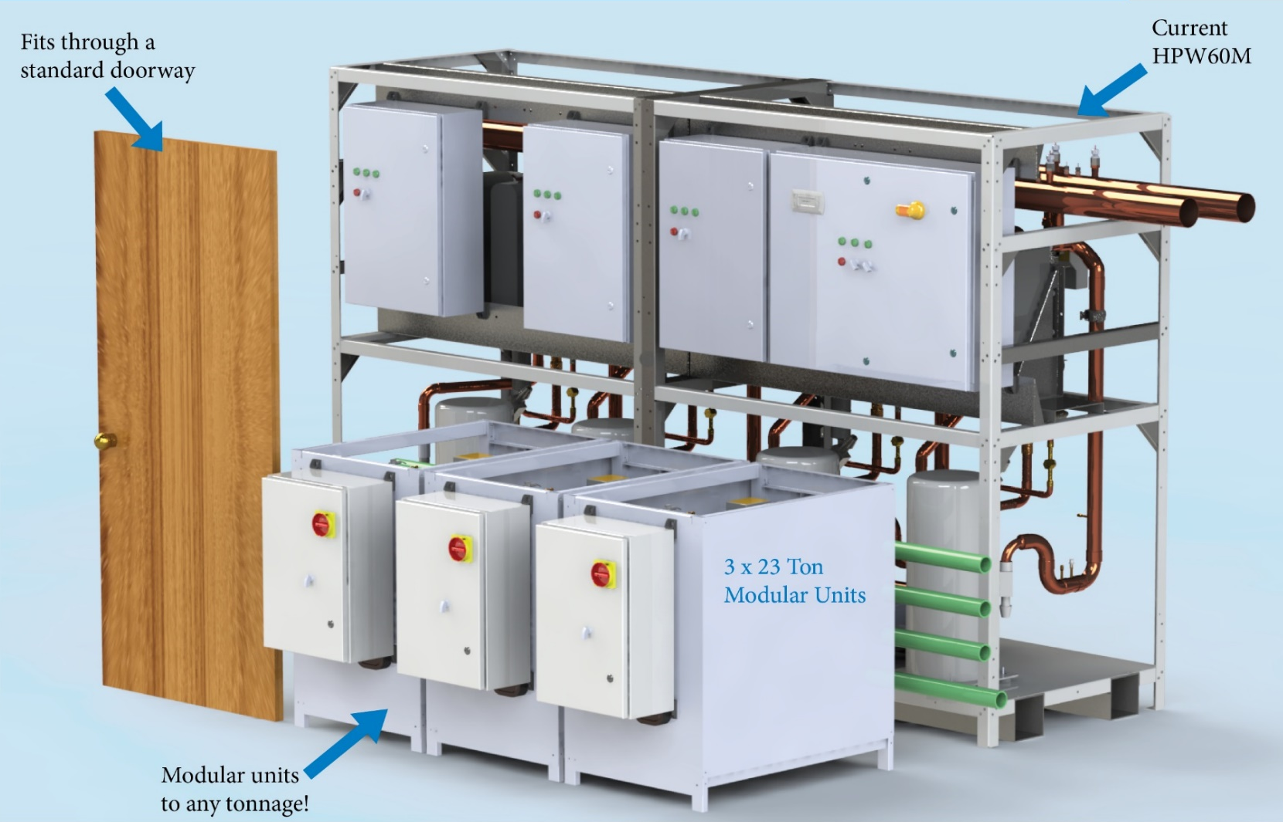
CxW Reduced Size

Slide 31
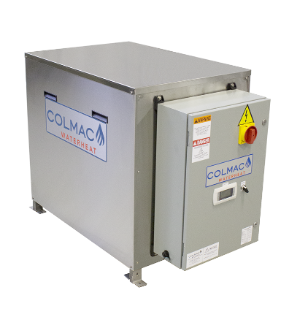
CxW Operating Range
45°F (6C)
85°F (29C)
110°F (43C)
High Temp Compressor
Notes:
Source temps down to 20F if source fluid allows

Slide 32
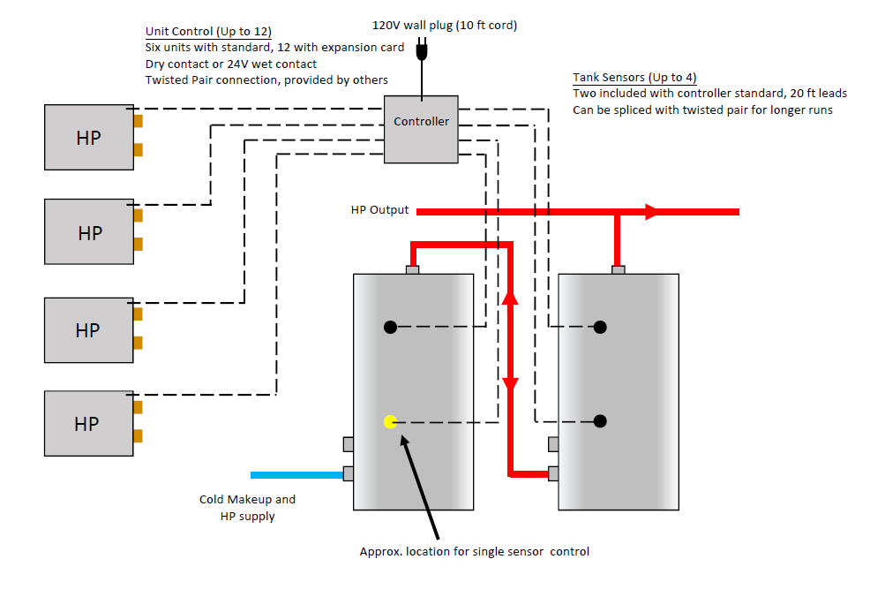
Staging Controller

Slide 33

Packaged Skids
  Colmac piping method and required plumbing components
  Factory assembled and tested
  Copper, Stainless or Aquatherm

Slide 34
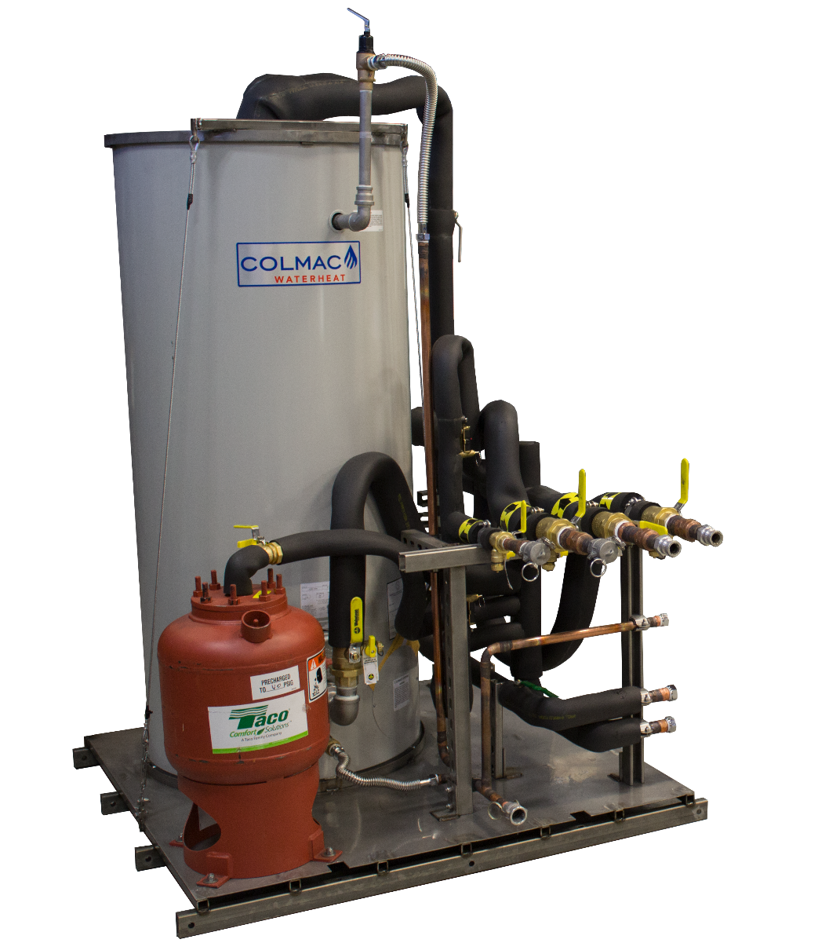
Packaged Skids
  Copper, Stainless or Aquatherm
  Other specified components
  Master controller for entire hot water system

Slide 35

Additional resources available at colmacwaterheat.com

Slide 36
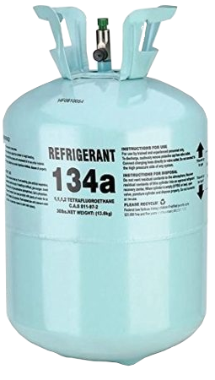
HFC Refrigerants
    R-410a GWP: 2,088
    R-134a GWP: 1,430
    Common components and servicing
    Phasing out to HFO replacements

Slide 37
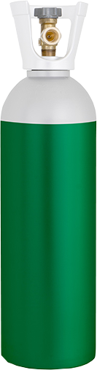
Natural Refrigerants
    R-744 (CO2) GWP: 1
    R-717 (Ammonia) GWP: 0
    R-290a (Propane) GWP: 3
    Low-temperature operation
    Limited components and servicing
    Pressure, flammability, toxicity

Slide 38
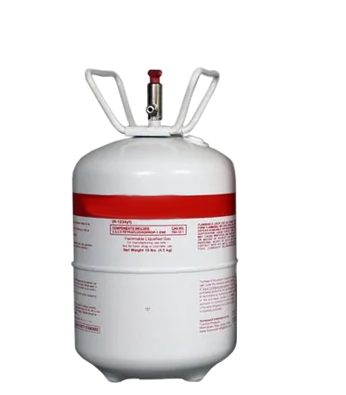
HFO Refrigerants
  R-1234yf GWP: 1
  R-1234ze GWP: 1
  Currently limited component availability
  Flammability: A2L, A3 Classifications

